Slide 1
11th Grade
Calcium paint

Slide 2
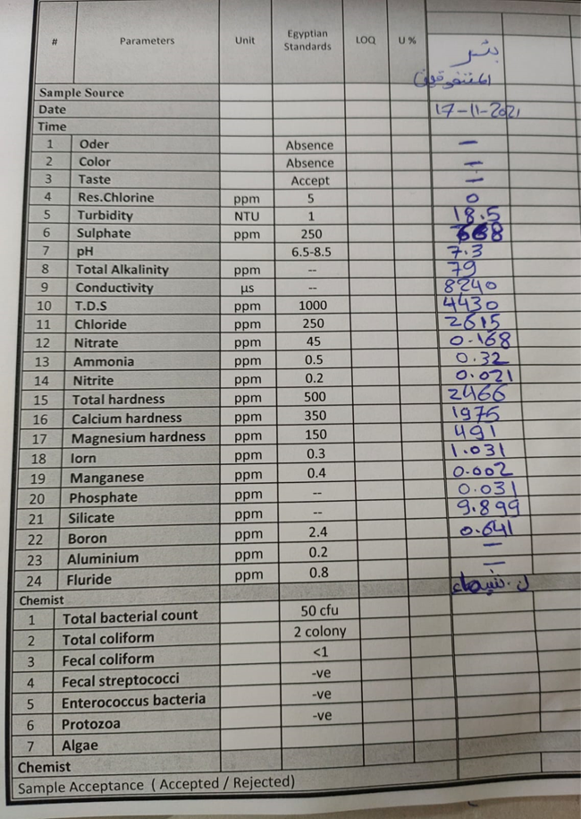

Slide 3
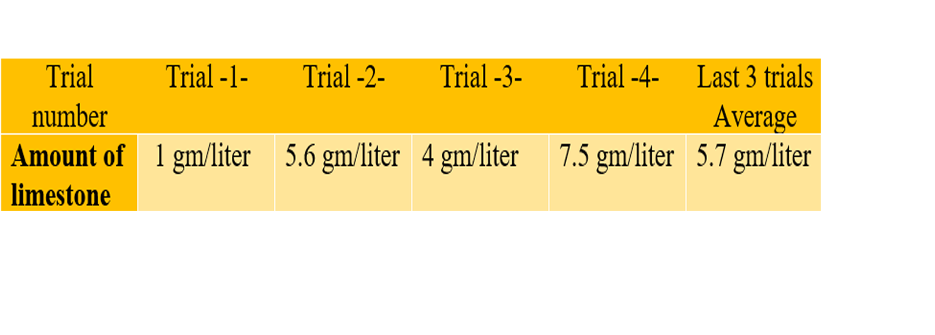
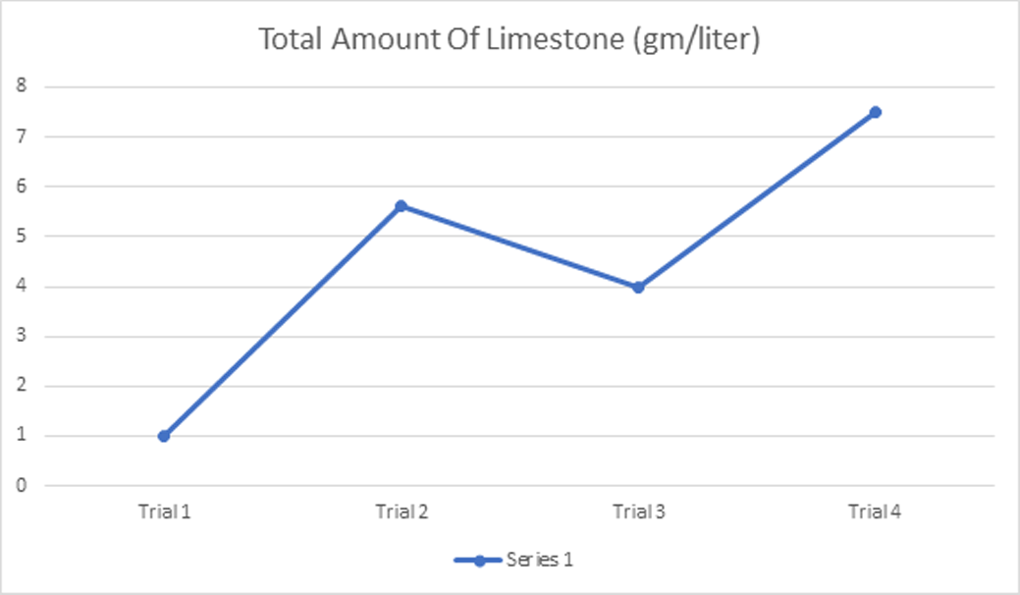
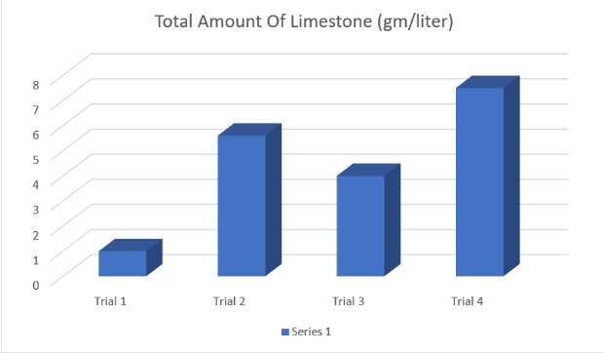

Slide 4
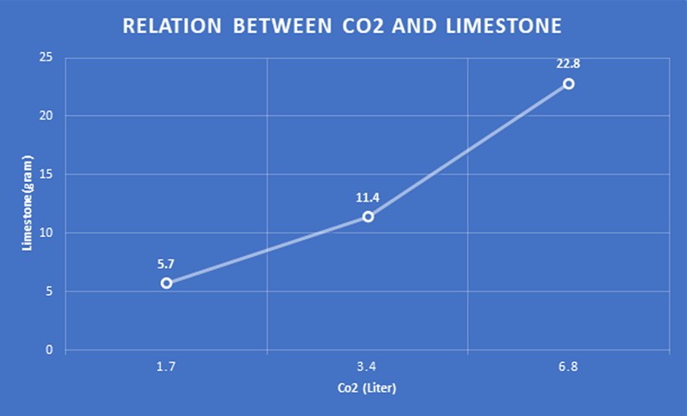

Slide 5
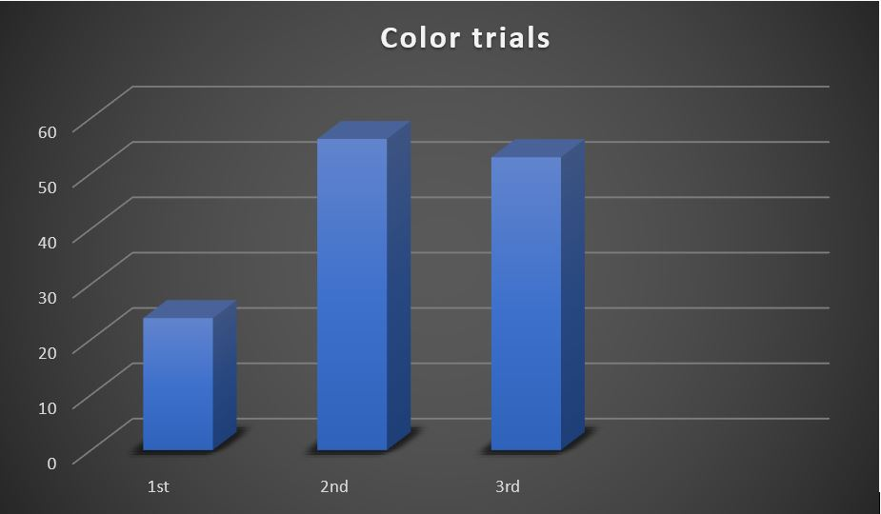
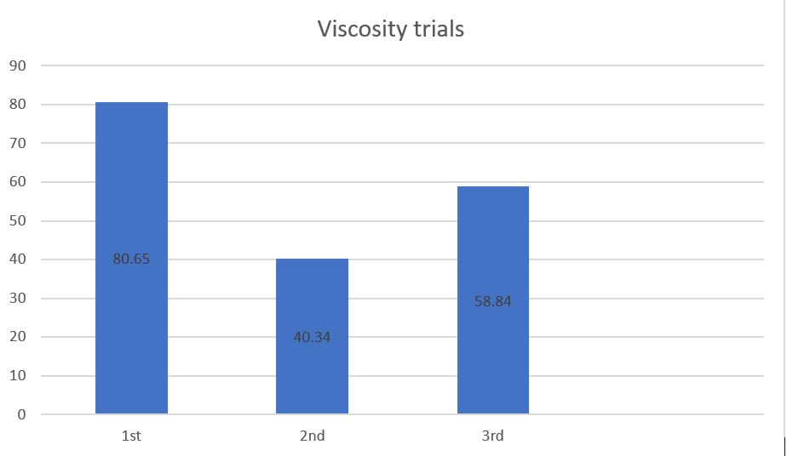
Results of viscosity and color
Trial no. | Color | Viscosity
1st | 23.87 | 80.65
2nd | 56.24 | 40.34
3rd | 52.94 | 58.84
Average | 44.35 | 59.94

Slide 6
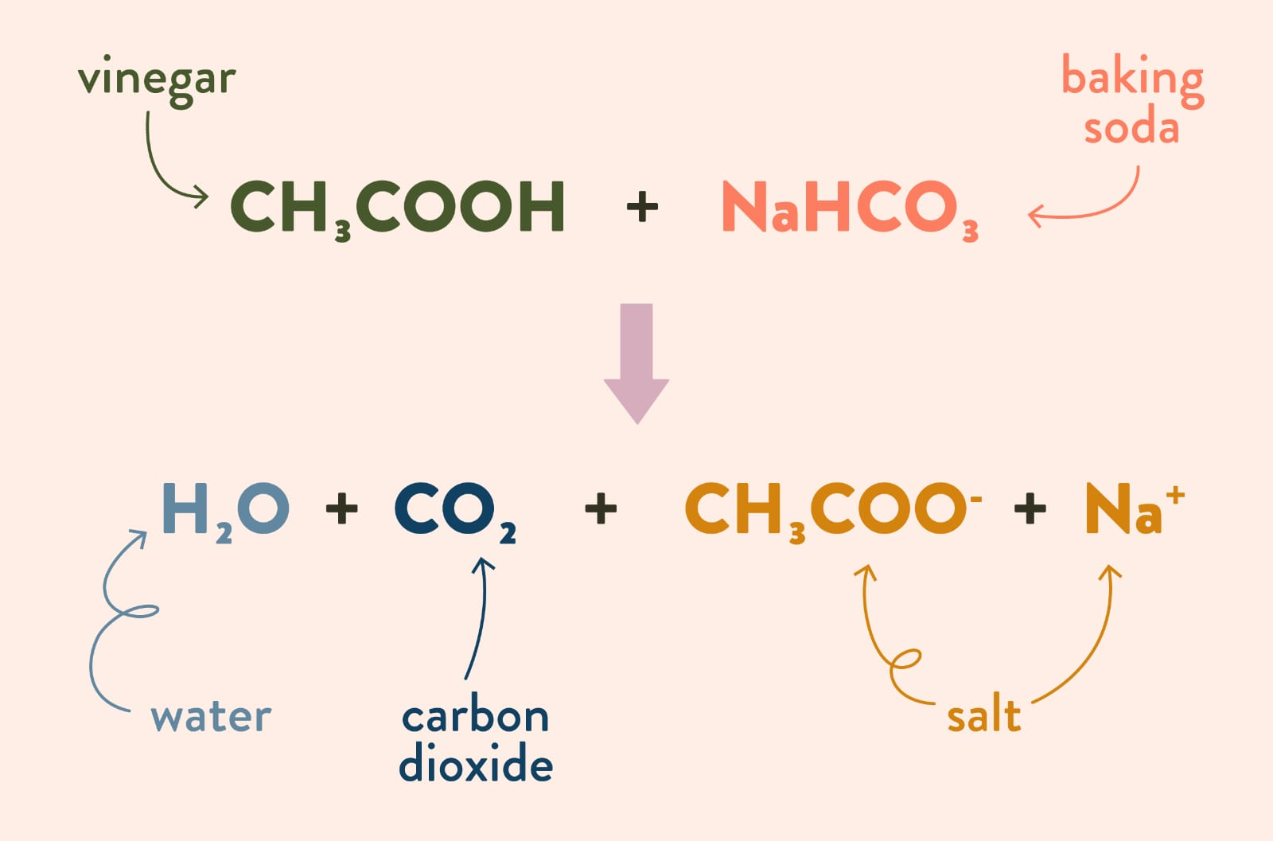

1 mole of washing soda = 84 grams
1 liter of vinegar contains x grams
Density = 0.75 g/ml
$\frac{X}{1000}$ = 0.75 >>>>>> X = 750 g
“n” moles = $\frac{750}{60}$ = 12.5 mol
1 liter 12.5 mol
“y” liters 1 mol
Y = $\frac{1∗1}{12.5}=0.08 L$ = 80 ml
80 ml : 84 g

Slide 7
Analysis
7819.5 g/m^3 of limestone
5700 ± 10 g
Why and how is the limestone produced?

Slide 8
H2O + 2Na + Co2 → Na2Co3 + H2 ↑
H2O + Ca + Co2 → CaCo3 + H2 ↑
At TDS = 4430 ppm__Ca = 1975 ppm (mg/L)__Na = 1250 ppm
CaCo3 & Na2Co3; both are the composition of limestone.
The Formation process of limestone (Theoretically):
mg/L to g/m^3

Slide 9
Ca (1975 mg/L) 1975 g/m^3 (Ca M is 40 g/mol)
Ca_{n} = 1975/40 = 49.4 mol
Ca_{n} = Co3_{n} = 49.4 mol
49.4*60 = 2962.5 g
(2962.5 + 1975) = 4937.5 g/m^3 (CaCo3) (1)

Slide 10
Applying the same process of Ca on Na:
Na (1250 mg/L) 1250 g/m^3
Na_{n} = 1250/23*2 = 27.2 mol
Co3 valency is 2 and Na is 1
Na_{n} = Co3_{n} = 27.2 mol
27.2*60 = 1632 g
1632 + 1250 = 2882 g (Na2Co3) (2) (1) + (2) = 2882 g + 4937.5 g = 7819.5 g

Slide 11
This is: “Why is this amount specifically produced?”

Slide 12
Why well water?
for example:
Water type | Seawater | Well water
TDS | 37000 ppm | 4430 ppm
Ca | 400 | 1975

Slide 13
Na2Co3 (27 mol) * 22.4 >>>> liters >>> 604.8 L
CaCo3 (49.4 mol)*22.4 >>> liters >>> 1106.56 L
Small scale >> > 0.6 + 1.1 = 1.7 liters
Graph 2

Slide 14
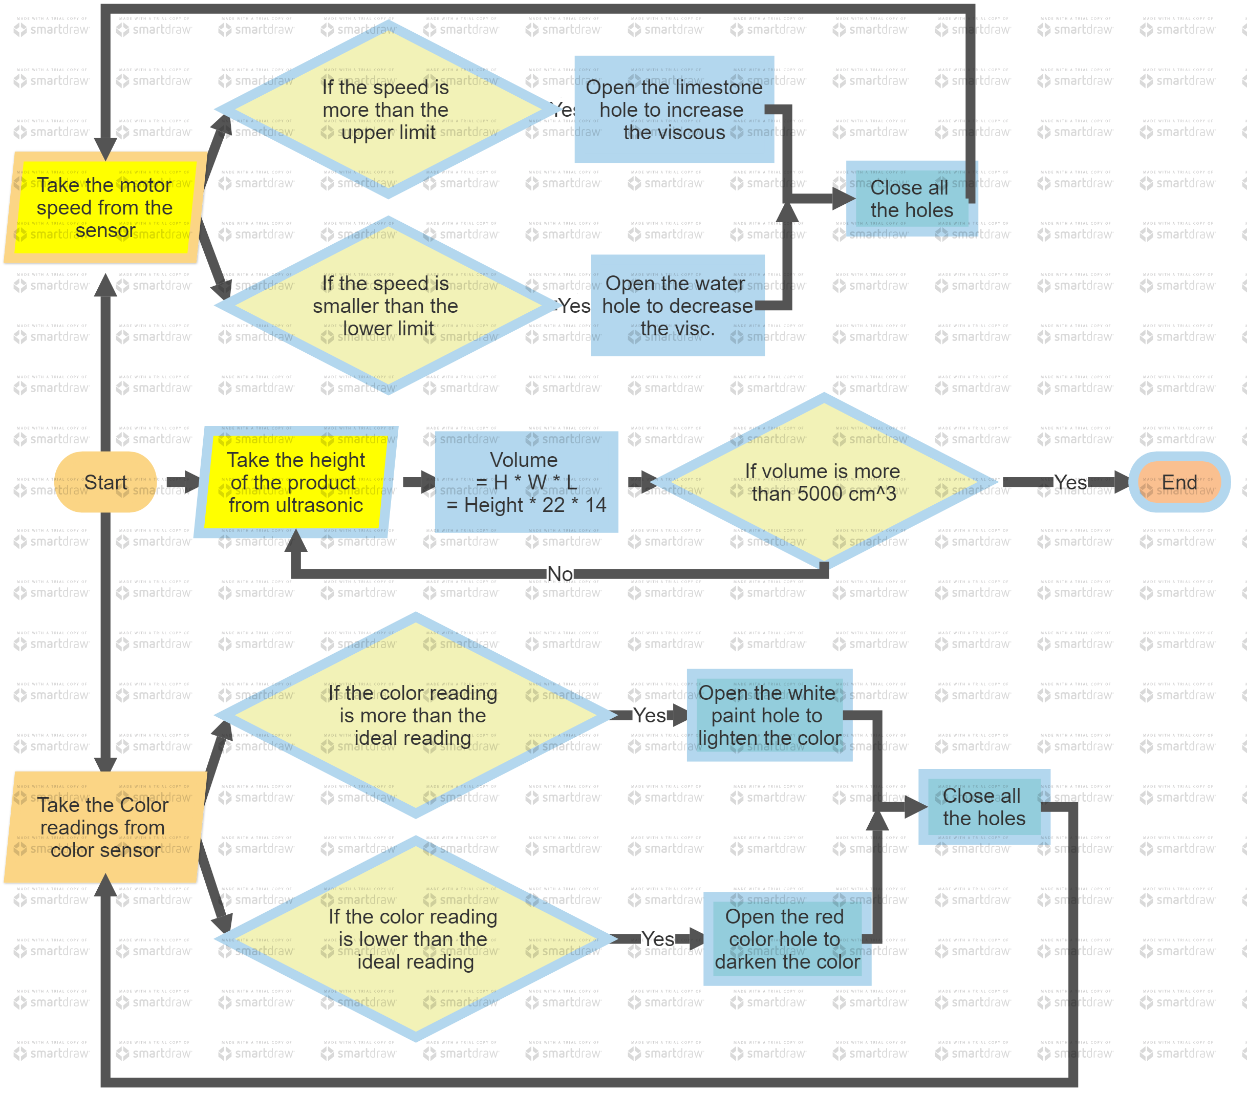

Slide 15
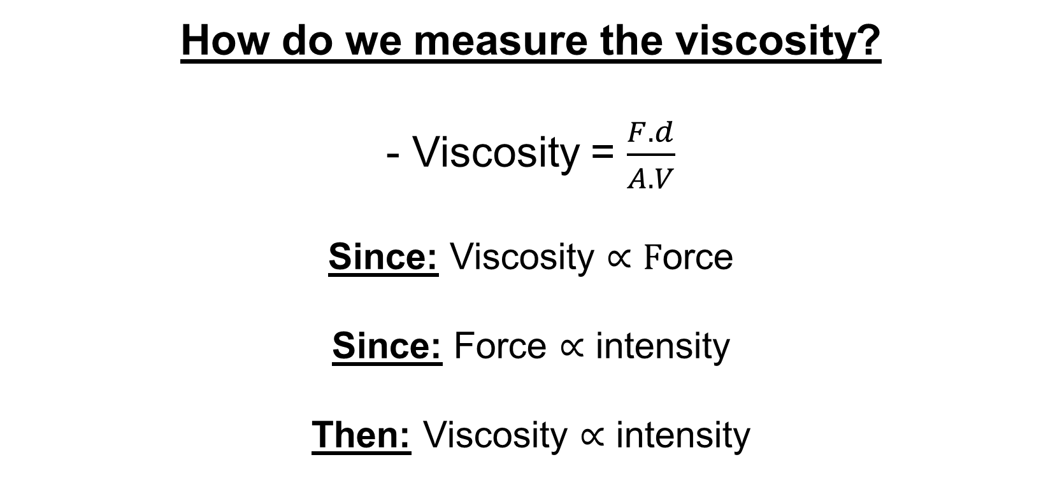
How do we measure the viscosity?
- Viscosity = $\frac{F.d}{A.V}$
Since: Viscosity $∝F$orce
Since: Force $∝$ intensity
Then: Viscosity $∝$ intensity

Slide 16
1 mole of washing soda = 84 grams
1 liter of vinegar contains x grams
Density = 0.75 g/ml
$\frac{X}{1000}$ = 0.75 >>>>>> X = 750 g
“n” moles = $\frac{750}{60}$ = 12.5 mol
1 liter 12.5 mol
“y” liters 1 mol
Y = $\frac{1∗1}{12.5}=0.08 L$ = 80 ml
80 ml : 84 g

